Slide 1
Sasha Research Sources
Summer 2023

Slide 2
Week of 6/12/23

Slide 3
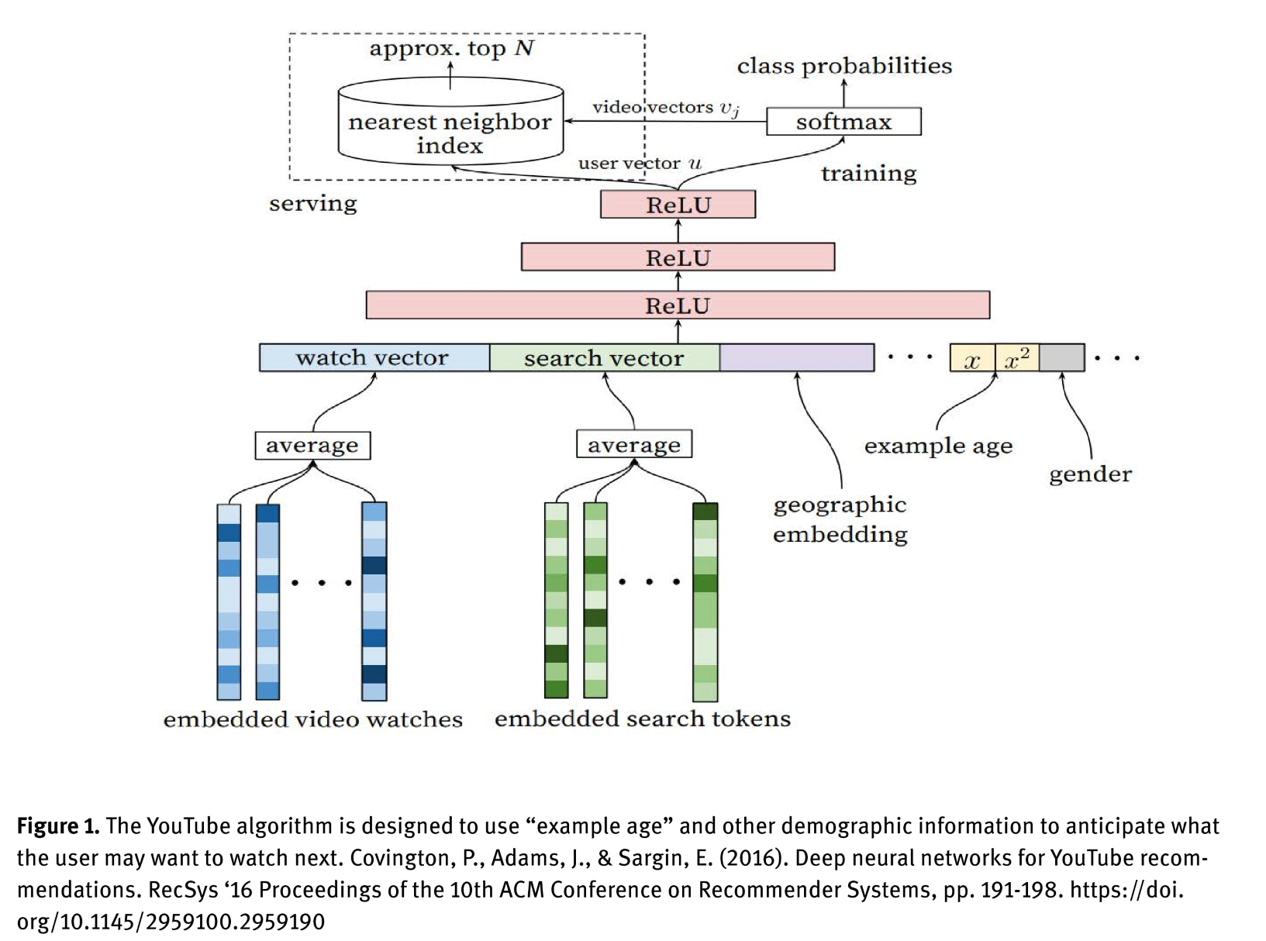
The YouTube Algorithm and the Alt-Right Filter Bubble
Lauren Valentino Bryant
Summary blurb: The YouTube algorithm measures relationships between videos and suggested videos, and tracks whether or not users clicked from one to the other. This tracking data feeds a neural network system whose aim is to suggest content that keeps users as engaged as possible. More time watching videos == more opportunities for advertisements. However, more “tightly bound” relationships were found between right-wing extremists videos (meaning it’s easier to get to increasingly polarizing right-wing content) than left-wing videos. This creates a “filter bubble” in which search algorithms only surround users with their own viewpoints, leading to an absence of diversity of thought.
Relevance to work: The figure to the right is the first diagram I’ve found so far that actually breaks down the technical components of the algorithm. The article admits that YouTube’s algorithm is very “black box,” even to its own engineers, so we don’t have hard code or anything like that. But this is a good start.
Tags: radicalization algorithms

Slide 4
Twitter's Algorithm: Amplifying Anger, Animosity, and Affective Polarization
Smitha Milli , Micah Carroll , Sashrika Pandey , Yike Wang , Anca D. Dragan
Summary blurb: This paper claims that the Twitter algorithm amplifies tweets that express strong emotions, particularly anger. In regards to political tweets, the Twitter algorithm actually presents tweets from out-groups (somewhat avoiding filter bubbles). However, the out-group tweets selected are those that express these strong emotions, and are therefore more divisive. This demonstrably contributes to negative perceptions of out-groups and more positive perception of the user’s in-groups.
Relevance to work: This paper points out the challenges in similar papers on social media algorithms—we don’t have access to these algorithms, so we can only do research by “testing” the algorithm via observational methods. However, like the previous slide, I think that these sorts of observational methods are a good starting point when we don’t have any kind of code access.
Tags: radicalization algorithms

Slide 5
A New Approach? Deradicalization Programs and Counterterrorism
International Peace Institute
Summary blurb: This paper documents several case studies of different countries’ efforts to deradicalize Islamic terrorists. Many of the eight countries profiled offered resources to the families of those involved with (or imprisoned for) terrorist crimes; focus on family and social ties were believed to help prevent families and social networks from developing hatred and consequent violent radicalization. Some countries aimed to rehabilitate individuals involved in terrorism; methods of doing so included job training, education, and even marriage support. These varied approaches have been subject to much criticism, including “tough on crime” versus “soft on crime” debates, as well as concerns over “rewarding” terrorism by providing resources to involved individuals.
Relevance to work: I wanted to look a little into “deradicalization” techniques from the social sciences side because I wanted to see what there could possibly be mapped to a digital application.
Tags: religious nationalism

Slide 6
Weekof 6/19/23

Slide 7
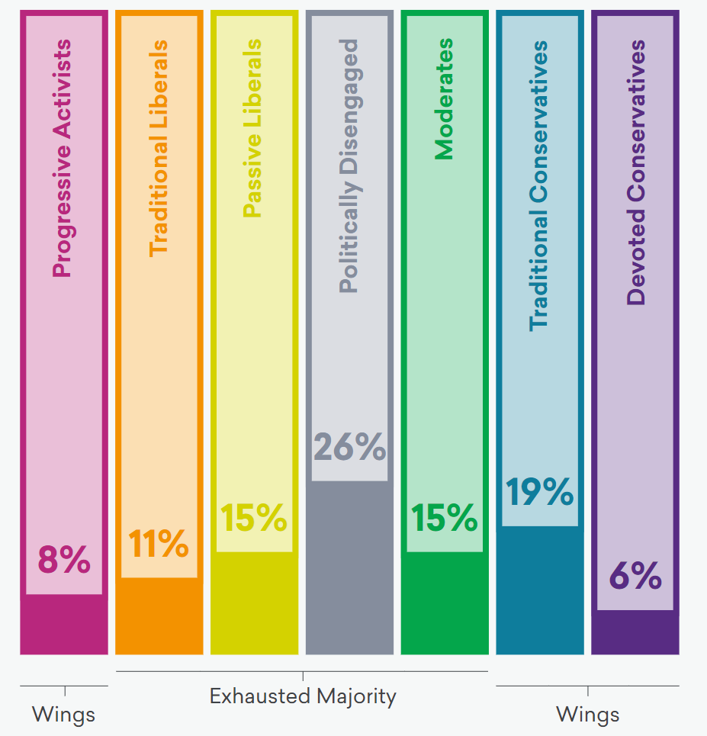
The Hidden Tribes of America
Summary Blurb: This 195-page report outlines a study performed on over 8,000 Americans (demographics reflective of the U.S. Census). The aim of this study was to understand political polarization in the U.S., as well as identify the main ideological groups that Americans fall into. Results found seven different groups with varying degrees of political engagement, and a wide variety of views on divisive topics (as well as differences in willingness to engage differing opinions).
Relevance to Work: This study provides a lot of good information as to how different kinds of political Americans operate (which is handy for the YouTube simulation).
Tags: religious nationalism

Slide 8
Title
Summary Blurb
Relevance to Work
Tags

